Slide 1
Automation Transformation-16th OCT

Slide 2
Distribution Of Automation Resources/SQL Developer Resources
Sr. # | Resource Name | Primary Skills | UI Path Exp. | Project Details
1 | Deepak Das | Work soft | Basic Training Completed | TMS E2E Automation
2 | Suresh Kola | Work Soft | Basic Training Completed | TMS E2E Automation
3 | Ekta Agrawal | Work soft | Basic Training Completed | IGNITE-Exceedra Automation
4 | Chinmayee Khadapkar | Work soft | Basic Training Completed | IGNITE-Exceedra Automation
5 | Priyanka Gupta | Work soft, UFT | Basic Training Completed | SAP-Monthly Regression/Dry Run
6 | Sumit Sharma | Work Soft | Basic Training Completed | Alchemy MDM
7 | Kalpesh Badjate | Selenium | Planned | Snap Logic and MS Patch Regression
8 | Harish Mallikondla | UI Path | Yes | IGNITE-Exceedra Automation
9 | Kunal Sawner | Blue Prism, UI Path | Yes | TMS E2E Automation
10 | Naman Awasthi | Work Soft/Tempo | Not Planned | Exceedra API & Interface testing (they are used for supporting monthly regression execution)
11 | Nilesh Kalwar | Work Soft/ParaSoft | Not Planned | Exceedra API & Interface testing (they are used for supporting monthly regression execution)
12 | Pooja Shinde | Work Soft | Basic Training Completed | Alchemy PLM
13 | Rajneesh Yadu | UI Path | Yes | SAP BW Back End Automation
14 | Gaurav Mallik | Work Soft, UFT | Basic Training Completed | SAP BW Back End Automation
15 | Rajib Ghosh | Work Soft | Basic Training Completed | Data Set Improvement for Regression Suite
Sr. # | Resource Name | Primary Skills | Project Details
1 | Erivan Vazquez | SQL Developer | Project One
2 | Sanjay Pradhan | SQL Developer | Project One
3 | Sachin Joshi | SQL Developer | SAP BW
4 | Rakesh Pani | SQL Developer | SAP BW
Notes:
UFT licenses are expiring on 20 March 19

Slide 3
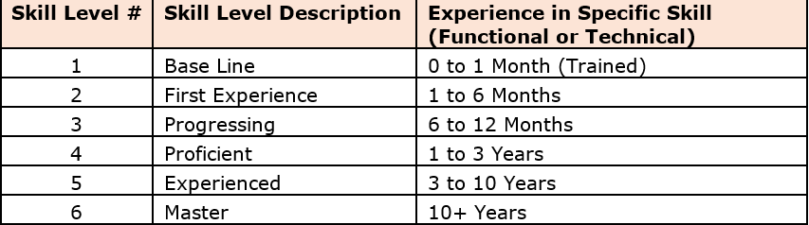
Skill Matrix for Automation Resources
Sr. # | Resource Name | Worksoft | UI Path | Selenium | YAML | JAVA | Python
1 | Deepak Das | Experienced | First Experience | NA | NA | NA | NA
2 | Suresh Kola | Experienced | First Experience | NA | NA | NA | NA
3 | Ekta Agrawal | Experienced | First Experience | Base Line | NA | NA | NA
4 | Chinmayee Khadapkar | Progressing | First Experience | Base Line | NA | NA | NA
5 | Priyanka Gupta | Progressing | Base Line | Base Line | NA | NA | NA
6 | Sumit Sharma | Experienced | First Experience | NA | NA | NA | NA
7 | Kalpesh Badjate | NA | Base Line | Experienced | NA | NA | NA
8 | Harish Mallikondla | NA | Proficient | NA | NA | NA | Base Line
9 | Kunal Sawner | NA | Progressing | NA | NA | NA | NA
10 | Naman Awasthi | Progressing | Base Line | Base Line | NA | NA | Base Line
11 | Nilesh Kalwar | First Experience | Base Line | Base Line | NA | NA | NA
12 | Pooja Shinde | Progressing | First Experience | Base Line | NA | NA | NA
13 | Rajneesh Yadu | Base Line | Progressing | NA | NA | NA | NA
14 | Gaurav Mallik | Progressing | First Experience | NA | NA | NA | NA
15 | Rajib Ghosh | Progressing | First Experience | Base Line | NA | NA | NA
Notes:
UFT licenses are expiring on 20 March 19

Slide 4
License Usage for Worksoft and Ui Path
Tools License/Weeks | 16-Oct | 23-Oct | 30-Oct | 6-Nov | 13-Nov | 20-Nov | 27-Nov | 4-Dec | 11-Dec | 18-Dec | 25-Dec
Ui Path-1 | IGNITE | IGNITE | IGNITE | IGNITE | IGNITE | IGNITE | IGNITE | IGNITE | IGNITE
Ui Path-2 | IGNITE | IGNITE | IGNITE | IGNITE | IGNITE | IGNITE | IGNITE | IGNITE | IGNITE
Ui Path-3 | IGNITE | IGNITE | IGNITE | IGNITE | IGNITE | IGNITE | IGNITE | IGNITE | IGNITE
Ui Path-4 | IGNITE | Alchemy | Alchemy | Alchemy | Alchemy | Alchemy | Alchemy | Alchemy | Alchemy | Alchemy | Alchemy
Ui Path-5 | TMS | TMS | TMS | Alchemy | Alchemy | Alchemy | Alchemy | Alchemy | Alchemy | Alchemy | Alchemy
Ui Path-6 | ALCHEMY | TMS | TMS | Alchemy | Alchemy | Alchemy | Alchemy | Alchemy | Alchemy | Alchemy | Alchemy
Worksoft-1 | Regression | Data Improvement | Data Improvement | Data Improvement | Regression | Data Improvement | Data Improvement | Data Improvement | Regression | Data Improvement | Data Improvement
Worksoft-2 | Regression | SAP BW | SAP BW | SAP BW | Regression | SAP BW |  |  | Regression
Worksoft-3 | Regression | SAP BW | SAP BW | SAP BW | Regression | SAP BW |  |  | Regression
Worksoft-4 | Regression |  |  |  | Regression |  |  |  | Regression
Worksoft-5 | Regression |  |  |  | Regression |  |  |  | Regression
Notes:
UFT licenses are expiring on 20 March 19

Slide 5
Automation Progress across Projects
S # | Projects/Tasks | Project Type | Status | Comments
1 | IGNITE | Strategic | In Progress | Total Manual Scripts: 1200 Planned Automated Scripts: 100 (for SIT), additional 50 (end of hypercare) Overall automation target 12.5% by end of Phase 1A In Progress: 10, Completed: 30 BOT configuration setup on orchestrator is completed – Sales Order creation Team worked on SAP Performance testing activity scripts, Open orders, invoice creation, Fund Accural Program Exceedra functionality are blocked due to open functional defects Facing performance issues with Exceedra(Defect- DPRIG-724) Funds: Analyzed the given scope, blocked with promotion creation – linked defect: DPRIG-724
2 | SAP BW | Strategic | In Progress | Total Manual Scripts: 400 (FE + SEM + BE) Revised Automated Scripts Plan: 10 (FE) & 70 (BE) Overall automation target 20% Execution Status- Passed: 227, Failed: 96 Had a discussion with Functional Team. Got KT for Back End Testing. Using Worksoft to create E2E Automation.
3 | TMS | Strategic | In Progress | Total Manual Scripts: 88 Planned Automated Scripts: 23 Overall automation target 28% In Progress: 3, Completed: 5 We were facing issues with TP(204,990,214 In bound error’s) till last week. We have reported these issues to the functional team. Everyday TP is down for 1 hour. Supporting PT team to create delivery, perform picking, process the shipment, perform PGI and Proforma(SE38), using Worksoft

Slide 6
Automation Progress across Projects
S | Projects/Tasks | Type of Project | Status | Comments
4 | Rapid Response | Strategic | In Progress | RR is traversing across multiple application(Java Application, SAP ECC, Talent(System App) and RR.). So, It’s a good candidate for Ui Path. Received the manual document from Henry and he explained the business flow related to RR Completed the POC or feasibility for Automation of Rapid Response Provided the LOE
5 | Alchemy(PLM and MDM) | Strategic | In Progress | Creating scripts on QA environment for PLM and Sandbox for MDM In progress: 2, Completed: 19 Working on the step level reporting to upload it in JIRA
7 | SKYNET | Strategic | Not Started | Had discussion with the functional team. Identified the SAP Test cases which can automated as part of SIT Scope not yet decided for HRC application
6 | Test Data Improvement | Non-Strategic | In Progress | Analyzed previous Regression cycle data and identified repetitive failed test cases Working with the functional team to capture the test data Modifying the scripts to identify data at run time and use the same set of data to execute the script. Completed: 8 , In Progress: 1
Notes:
UFT licenses are expiring on 20 March 19

Slide 7
Additional Automation Tasks Performed for Multiple Projects
Performance Activities
 | Sl. No. | Project | Total Test Cases | Completed | In Progress | Testing Status | Planning To Process #Orders | Comment
 | 1 | IGNITE | 4 | 2 | 2 | In Progress | 2k | Creating a script for bulk order creation in extracting order number/order net value to specific material that can be utilized for SIT/UAT phase as per Arpita’s demand. Facing issue with test data.
 | 2 | TMS | 2 | 2 | 0 | Completed | 800 | Completed execution of 800orders over the weekend. Process involves Creation of Delivery till Performa
Data Creation Activity
 | Sl. No. | Project | Orders Created | Comment
 | 1 | TMS-UAT | 400 | Create open orders to support UAT for TMS for the Request TMSTR 79 BBB 200 ASAP
 | 2 | TMS-UAT2 | 200 | Create open orders to support UAT for TMS for the Request TMSTR 79 BBB 200 ASAP
 | 3 | SAP BW Back End Testing | 227 | To support the SIT, we created order and process it till invoice in the Source System.
 | 4 | Project-ONE | 400 | On the request of Mallik we created orders to shipment(ZVT01N). To support the testing
Notes:
UFT licenses are expiring on 20 March 19

Slide 8
Automation Matrix Across Projects
Step Level Status
SL # | Project Name | # Total Step at Project Lvl | # Target Steps to automated | %Planned | # Step Automated | % Actually Automated | Comments
1 | TMS | 2764 | 1257 | 45% | 329 | 12% | Creating E2E TC’s for Regression
2 | IGNITE | 30587 | 2237 | 7% | 468 | 2%
3 | SAP-BW | 5577 | 1170 | 21% | 120 | 2% | Automated 10 TC's for front end and planning rest 70 for back end
4 | ALCHEMY(PLM+MDM) | 6000 | 1000 | 17% | 400 | 7% | For Cycle 1 and 2
Test Case Level Status
Sl. No | Project Name | Total Manual Test Cases | Total No of Test Case to automate | Automation % | # Test Cases Automated | % Actually Automated
1 | TMS | 88 | 23 | 26% | 5 | 6%
2 | IGNITE | 1500 | 150 | 10% | 30 | 2%
3 | SAP BW | 760 | 80 | 11% | 10 | 1%
4 | ALCHEMY | 2500 | 200 | 8% | 19 | 1%
5 | Rapid Response | 10 | 10 | 100% | 1 | 10%
Notes:
UFT licenses are expiring on 20 March 19

Slide 9
IGNITE Automation Status
Sl. No. | Module Name | Total Test Cases | Completed | In Progress | Blocked | Not Started | Testing Status | Comment
1 | SAP_ Transactional DI | 11 | 11 | 0 | 0 | 0 | Completed | SAP scripts are completed.
2 | Exceedra Targets | 2 | 2 | 0 | 0 | 0 | Completed | Scripts are completed, no more in automation scope.
3 | Exceedra Funds | 4 | 0 | 1 | 3 | 0 | Blocked | Automation of Creation of fund is completed, not able to proceed for verification steps.
4 | Exceedra Base Volume | 1 | 0 | 0 | 1 | 0 | Blocked | Calendar values are not displaying. Not able to proceed
5 | Exceedra OI Creation | 4 | 0 | 1 | 3 | 0 | Blocked | Existing functional defect.
6 | Exceedra Promotions | 24 | 1 | 3 | 20 | 0 | Blocked | Not able to create a complete flow of promotion. Exceedra application taken more than 4 min to navigate next screen. Developing SAP part of promotion.
7 | Exceedra Terms | 35 | 16 | 6 | 10 | 3 | In Progress | Manual Test cases need update, not working as expected.
 | Total Scripts | 81 | 30 | 10 | 14 | 27
Status on 16th OCT
Notes:
UFT licenses are expiring on 20 March 19

Slide 10
Rapid Response Estimations
S/N | RR Modules | # Test Steps | Scripts Creation | Review/ Update | # Test Steps (New Count) | Automation Estimates (Hrs) | Automation Estimates (Days)
1 | Sales and Operations Planning (S & OP) | 20 | 30 hrs effort across 4 weeks schedule | Scripts Review with Julie and Harshil - 2 weeks depending on their availability | 30 | 37.5 | 4.2
2 | Demand Planning (DP) | 20 |  |  | 30 | 37.5 | 4.2
3 | Aggregated Supply Planning (ASP) | 16 |  |  | 24 | 30 | 3.3
4 | Inventory Management (IM) | 24 |  |  | 36 | 45 | 5.0
5 | Inventory Planning and Optimization (IO) | 24 |  |  | 36 | 45 | 5.0
6 | Distribution Requirements Planning (DRP) | 20 |  |  | 30 | 37.5 | 4.2
7 | Order Fulfilment (OF) | 24 |  |  | 36 | 45 | 5.0
8 | Capacity Planning (CP) | 24 |  |  | 36 | 45 | 5.0
9 | Master Production Scheduling (MPS) | 20 |  |  | 30 | 37.5 | 4.2
 |  |  |  | Automation_Total Hrs | 360
 |  |  |  | Automation_Total Days | 40.0
 |  |  |  |  |  | Functional KT | 90
 |  |  |  |  |  | Manual Dry Run | 30
 |  |  |  |  |  | Automation Script Design | 360
 |  |  |  |  |  | Automation Dry Run | 81
 |  |  |  |  |  | Reporting | 20
 |  |  |  |  |  | Total Hrs | 581
 |  |  |  |  |  | Total Days | 64.6
Notes:
UFT licenses are expiring on 20 March 19

Slide 11
Tools Implementation Updates
S # | Tasks | Status | Impact | Work Around | Comments
1 | Worksoft Execution Manager Set Up/Lights Out Testing | Issue | Medium | Un-attended execution can also be achieved by CMD batch execution. | 08/28- Batches are getting aborted automatically. Raised a ticket with Worksoft Support team(Ticket Number- 00035045). 08/30- Worksoft support team suggested that the issue is because of the CA Identity Minders is installed on the server. We need to uninstall the CA related apps. We have raised a service request. 09/05- The windows team disabled the services of CA Identifies Minders. The frequency of aborted test cases are reduced. 09/14- Facing the same issue of Task Aborted for Batch runs. Test cases are getting Skipped in the batch. Ticket: 00035260 10/03- Getting new error message after changing the CB defense console 10/07- Issue got resolved. Still getting task abort but frequency is less
2 | Worksoft-JIRA Integration | Issue | Low | Creating it manually | 08/02- Getting blank XML file as an output while Integrating. Raised a Ticket with Worksoft Support Team.(Ticket:34701) 08/21- Had a discussion with the Engineering team. They suggested the issue is : JIRA login URL which we are using is .JSP. Got the resolution from JIRA support team. Performing curl installation On running CURL command getting authentication error. Need help from JIRA support JIRA support suggested that Worksoft-JIRA integration is not possible with 3rd Party SSO implementation(YAML) Performing the integration on JIRA development environment as SSO is not implemented
Notes:
UFT licenses are expiring on 20 March 19

Slide 12
Test Data Improvement for SAP Regression Suite

Slide 13
Progress on Test Data Improvement/Enhancement
Test Cases Identified | Completed
12 | 8
Notes:
UFT licenses are expiring on 20 March 19

Slide 14
VM Automation and Validation

Slide 15
Ui Path Power Shell Automation Estimations
Assumptions:
1. Assuming 15 scripts to be automated
2. Putty or WinSCP installed on the machine
3. Access and credentials provided for Putty and required applications
4. Test cases and Test data provided by the account team/Client
Process Complexity Classification
# | Criteria | Medium
1 | Identification of Process | Process which involves integration with multiple applications like (SAP application) also involves some validations, some coding techniques and integration with database.
2 | Input Data | Structured & UnStructured data
3 | No of Steps per Process | 15-20
4 | No. of Sub steps | 60-80
5 | No of Database Identified | 0
6 | No of Applications/Sytems identified for E2E Automation | 0
7 | No of Validations | 5-10 per script
8 | Report Generation | Yes
9 | Coding Techniques | Yes
10 | Percentage reuasble workflows | Yes
Notes:
UFT licenses are expiring on 20 March 19

Slide 16
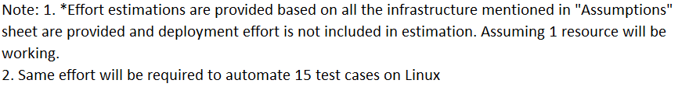
Ui Path Power Shell Automation Estimations
 | Medium
 | Infra Automation (Windows)
 |  | Per Process
 | # of TestCases => | 1
 | Bot Designing Activities | Efforts in Hrs
Bot Requirements Analysis & Review | Process Understanding & Analysis | 2.00
Bot Design & Testing | Designing Workflow | 40.00
 | Designing Sub Steps | 20.00
 | Validations | 20.00
 | Workflow Testing | 20.00
 | Report Generation | 20.00
 | Integration with different systems/Applications | 0.00
 | Total Bot Design & Testing Efforts in Hrs | 122.00
Notes:
UFT licenses are expiring on 20 March 19

Slide 17
Worksoft Regression Scope Enhancement

Slide 18
Enhancement of SAP Monthly Regression Suite
In ARG and Legal Documents project, we automated 27 TC’s which belongs to OTC-LATAM and FI. We will get these scripts reviewed from the functional SME’s and add the new and critical business process related scripts to the Monthly Regression scope.
As we are planning to automate the E2E scenario for TMS as part of regression, which are new functionality from the Transplace. This is the best candidate which can be added to the Monthly Regression Scope.
In IGNITE Project, we have 40 Manual test cases. We can automate some of the scenarios and can include them into our monthly regression suite.
Notes:
UFT licenses are expiring on 20 March 19

Slide 19

- -
How do we ensure our Automation is EverGreen
1
Feasibility
BRD and FSD’s the baseline to start for automation feasibility
Impact assessment can be done at SIT level where TC’s are written
Priority
For TMS we are automating the test cases at high priority to support SIT.
Deliverables
Automation Feasibility Report and scope of automation.
Where Used Report from SAP ECC
Automate business processes and end-to-end flows used frequently.
For Alchemy, automate test sets and test cases that needs to be executed with multiple sets of data variants to support SIT as well regression.
High Impact Objects and Related Test cases along with execution reports in JIRA.
Change Impact assessment report
Criticality (Risk score) is one of the basic factor to prioritize automation
Automation team is involve in the initial discussion of requirement understanding
For ARG and Legal documents Project, it includes new functionalities and tc’s can be added to existing regression suite.
Review New Projects
( Strategic)
Upcoming Projects
TMS
Alchemy
ARG and Legal Documents
IGNITE
1
2
Evaluate, Prioritize Key Enhancement
& Break Fix
Ongoing Monthly Manual Regression RUN
Monthly
Regression
Executions
Discover changes
Evaluate impact
Assess risk
Optimize test suite
Amend test Scripts
19
Execute Monthly
Test Automaton
Approve and deploy changes
We look at commonly-used, high-impact transport objects for below
Use of production environment data for testing.
Revisiting of current regression suite from the Team Leads to add on new functionality.
Identifying new functionality from current on-going project and adding on the functionality/changes

Slide 20
Re-Usability of Worksoft and Ui Path Scripts for Upcoming Projects.
S # | Triggering Ui Path Scripts using Worksoft | Triggering Worksoft Scripts using Ui Path | Triggering Ui Path and Worksoft Using JENKINs
1 | Using Step “Execute Application”: In Certify we have a step “Execute Application” which can call the Ui Path Robot. | Worksoft scripts can be triggered using .bat file by exporting the scripts to .bat file. In Ui Path we can trigger the Worksoft Scripts using CMD commands. | Both the Automation tools can be integrated with JENKINS. We can trigger 2 different processes(Worksoft and Ui Path) to perform the E2E testing. We can parse the values using Excel.
Notes:
UFT licenses are expiring on 20 March 19

Slide 21
Ui Path Set Up/Configuration

Slide 22
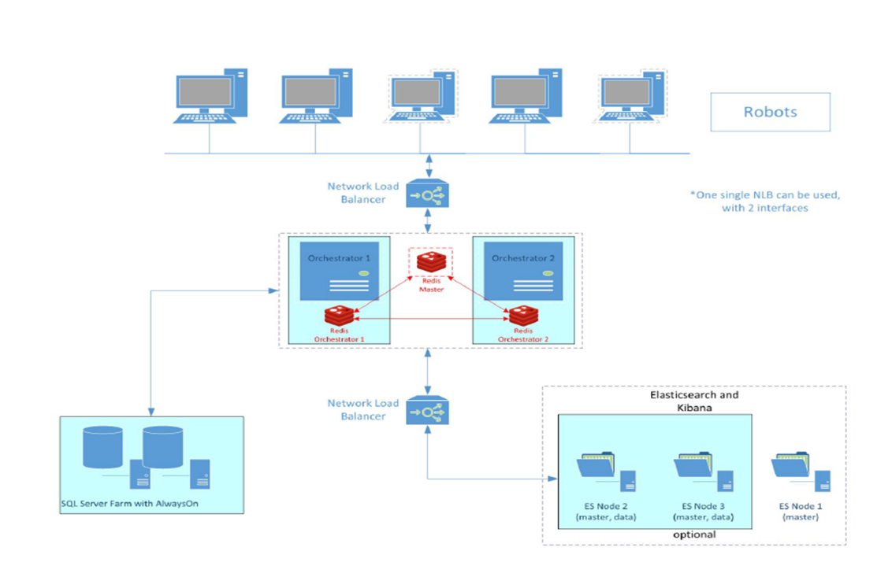
UI Path Set up/Configuration
Notes:
UFT licenses are expiring on 20 March 19

Slide 23
UiPath Installation Updates

Slide 24
UI Path Installation Updates
Sl. No | Prerequisite/Tasks | Prerequisite/Task | Status | Comments
12 | Creation of Tenants and Robot Set Up | Task | In Progress | 09/17: Robot set up is completed on 3 machines.
13 | Testing of Robot Set Up | Task | Completed | 09/18: Testing is completed. In case of any issues we will reach out to the IA Practice team.
Notes:
UFT licenses are expiring on 20 March 19

Slide 25
UI Path Installation Updates
Sl. No | Prerequisite/Tasks | Prerequisite/Task | Status | Comments
1 | Prerequisite software installation | Prerequisite | Completed
2 | Standalone UI Path Studio Installation | Task | Completed | 07/19: After installation, UI Path Studio was automatically getting aborted(INC1209231). 07/22: The Windows team re-installed Carbon Black and the issue was resolved.
3 | Testing of Standalone UI Path Studio | Task | Completed | 07/25: Completed the POC and Sign Off from Functional Team for Exceedra Application.
4 | Shared Drive with Credentials | Prerequisite | Completed | 07/25: Raised the service request for shared drive(RITM0539025). 07/25: Raised a smart request(128345). 07/26: Waiting for the Manager's approval. 07/29: The team confirmed that, they have created the Shared Drive and We mapped the drive into each servers.
5 | SQL credentials, ID which have DB creation access (dbowner access) or DB name which is already created(so that we can directly provide the name of DB during installation) | Prerequisite | Completed | 07/24: Raised a Incident for SQL DB creation. 07/25: Raised a service request (RITM0539689). The task was completed.
Notes:
UFT licenses are expiring on 20 March 19

Slide 26
UI Path Installation Updates
Sl. No | Prerequisite/Tasks | Prerequisite/Task | Status | Comments
6 | Credentials on which Orchestrator instance will be installed with Admin access | Prerequisite | Completed
7 | Domain SSL certificate. | Prerequisite | Completed | 07/22: Mail send to Jason for this request. 07/23: Jason completed this request.
8 | Site name for URL(DNS) | Prerequisite | Completed | 07/25: The URL’s are not added to the DNS servers. Service request was raised(RITM0539348). Following up with the concerned team to complete this ASAP. 07/26: The request was completed.
9 | Ports – 443 for Orchestrator – Robot interaction, 6379 – Redis, 9200 – ElasticSearch, 5601 – Kibana, SQL - 1433 | Prerequisite | Completed | 07/24: Raised an incident with the clorox service desk. 07/29: The Windows team has confirmed that the ports are allowed for Windows OS. We have asked them to make the status of the Incident be open. If we face any issues or challenges will reach out to them.
Notes:
UFT licenses are expiring on 20 March 19

Slide 27
UI Path Installation Updates
Sl. No | Prerequisite/Tasks | Prerequisite/Task | Status | Comments
10 | Installation and set up of Orchestrator(Both the nodes). | Task | Completed | 07/30: The installation is completed. Team is facing issue with Redis configuration and NLB configuration. 07/31: Raised a service request on 26 Jul. This request is again assigned to the Network team.
11 | Enable Orchestrator over cluster. | Task | Completed | 08/01:Service request was assigned to Archer for NLB configuration 08/02:Had a call with Archer and provided the necessary information 08/05: Had a call with Archer and provided the Keys for SSL certificate. 08/06: Need some support from onsite to work with Archer to complete this task. 08/20: Load balancing is completed by Archer. 08/21: We are yet to receive the Certificate in .PFX format from Jason to configure the Orchestrator. 08/23: Archer provided the certificate in .PFX format. 08/26: Configured primary node successfully but facing issues while configuring secondary node 08/26: Needs wild card certificate to configure both the nodes. Stacy will schedule a meeting to discuss this issue. 09/09: Had a discussion Archer, the 443 was already shared by another application(Load Runner). The same configuration needs to be done on a new server/Machine. Need to create a new database, the team facing issues while migrating the database.
Notes:
UFT licenses are expiring on 20 March 19

Slide 28
UiPath Best Practices

Slide 29
Project Organization
High-Level Frameworks
Robotic Enterprise Framework Template proposes a flexible high level overview of a repetitive process and includes a good set of practices described in this guide and can easily be used as a solid starting point for RPA development with UiPath. The template is built on a State Machine structure.

Slide 30
How it works:
The Robot loads settings from the config file and Orchestrator assets, keeping them in a dictionary to be shared across workflows
The Robot logs in to all applications, before each login fetching the credentials
It retries a few times if any errors are encountered, then succeeds or aborts
The Robot checks the input queue or other input sources to start a new transaction
If no (more) input data is available, configure the workflow to either wait and retry or end the process
The UI interactions to process the transaction data are executed
If the transactions are processed successfully, the transaction status is updated and the Robot continues with the next transaction
If any validation errors are encountered, the transaction status is updated and the Robot moves to the next transaction
If any exceptions are encountered, the Robot either retries to process the transaction a few times (if configured), or it marks the item as a failure and restarts
At the end, an email is sent with the status of the process, if configured

Slide 31
Designing Principles
Breaking the process in smaller workflows is paramount to good project design. Dedicated workflows allow independent testing of components while encouraging team collaboration by developing working on separate files.

Slide 32
Code Reusability
When developing, we often need to automate the same steps in more than one workflow/ project, so it should be common practice to create workflows that contain small pieces of occurring automation and add them to the Library.

Slide 33
How to check quality automation
Modularity
Separation of concerns with dedicated workflows allows fine granular development and testing
Extract and share reusable components/workflows between projects
Maintainability
Good structure and development standards
3. Readability
Standardized process structure encouraging clear development practices
Meaningful names for workflow files, activities, arguments and variables
4. Flexibility
Keep environment settings in external configuration files/Orchestrator making it easy to run automation in both testing and production environments
Reliability
Exception handling and error reporting
Real-time execution progress update
Extensible
Ready for new use cases to be incorporated

Slide 34
Thank you

